Slide 1
Lending Management

Slide 2
Principles of Lending
Principles of safety
Timely recovery of principal and interest
Diversification of loans
Obtaining the regular status of the borrower
Valuation of security given by borrower
Charging of interest rate to maintain margin
Principles of Liquidity
Inflows in the form of repayment of loans should match the demand of depositors as outflows
Minimization of gap between inflows and outflows

Slide 3
Principles of Lending Cont…
Principle of profitability
Profitability to be maintained to honour all the obligations
Principle of purpose
Loans only for productive purpose with a definite source of repayment
Principle of security
Primary Security and personal security
Principle of marketability
Security for loan should be freely marketable
Principle of value stability
Value of collateral should be stable

Slide 4
Regulation of Lending Activities
The mix, quality, and yield of the loan portfolio are heavily influenced by regulation
40 % of the credit to priority sector
Priority to Small and Medium Enterprises
Credit risk exposure limit to a single borrower is 15 percent and 5 percent extra for infrastructure projects
A bank cannot grant any loans and advances on the security of its own shares.

Slide 5
Regulation of Lending Activities Cont…
Without prior approval of the Board or without the knowledge of the Board, no loans and advances should be granted to relatives of the bank's Chairman/Managing Director or other Directors, Directors (including Chairman/Managing Director) of other banks and their relatives
Banks should not extend finance for setting up of new units consuming/producing the Ozone Depleting Substances
Restrictions on Advances against Sensitive Commodities under Selective Credit Control

Slide 6
Regulation of Lending Activities Cont…
16-6
Loan against shares, debentures and bonds may be granted to individuals to meet contingencies and personal needs or for subscribing to new or rights issues of shares / debentures / bonds or for purchase in the secondary market, against the security of shares / debentures / bonds held by the individual.
Loans against the security of shares, debentures and bonds should not exceed the limit of Rupees ten lakhs per individual if the securities are held in physical form and Rupees twenty lakhs per individual if the securities are held in dematerialised form
Banks should maintain a minimum margin of 50 percent of the market value of equity shares / convertible debentures held in physical form. In the case of shares / convertible debentures held in dematerialised form, a minimum margin of 25 percent should be maintained

Slide 7
Regulation of Lending Activities Cont…
A uniform margin of 50 per cent shall be applied on all advances / financing of IPOs / issue of guarantees on behalf of market makers. A minimum cash margin of 25 per cent (within the margin of 50%) shall be maintained in respect of guarantees issued by banks for capital market operations
Loans/advances to any individual from banking system against security of shares, convertible bonds, convertible debentures, units of equity oriented mutual funds and PSU bonds should not exceed the limit of Rs. 10 lakh for subscribing to IPOs
The interest rates for loans vary across the banks but it should be above the base rate. The base is determined on the basis of cost of deposits, CRR, SLR, overhead cost, return on equity.

Slide 8
Regulation of Lending Activities Cont…
The guidelines vary across the type of loans e.g. industrial loan. Loans for SMEs, agricultural loans etc.
The margin amounts vary on the basis of collateral used for the loans and it varies from time to time as per RBI guidelines
Different guidelines for individuals, directors of the bank, employees, groups etc.

Slide 9
Factors to Consider to Reduce Credit Risk in Loan Policy
Avoid high risk loans
Proper valuation of collateral
Diversification of loans
Proper documentation
Credit limits
Proper monitoring
Use of instruments to transfer risk

Slide 10
Steps in the Lending Process
Finding Prospective Loan Customers
Evaluating a Customer’s Character and Sincerity of Purpose
Making Site Visits and Evaluating a Customer’s Credit Record
Evaluating a Prospective Customer’s Financial Condition
Assessing Possible Loan Collateral and Signing the Loan Agreement
Monitoring Compliance with the Loan Agreement and Other Customer Service Needs

Slide 11
Evaluating a Loan Request
The Cs of Credit (Credit worthiness of the borrower)
Character
Personal characteristics of borrowers, honesty, specific purpose of loan and serious intent to repay the loan
Capacity
Legal authority to sign binding contract and cash flow
Cash / Capital
Financial condition of the borrower and ability to generate enough cash to repay loan
Collateral
Adequate assets to support the loan
Conditions
Economic conditions faced by borrower
Control / Compliance
Does loan meet written loan policy and how would loan be affected by changing laws and regulations

Slide 12
Evaluating a Loan Request…
Can the Loan Agreement Be Properly Structured and Documented?
This requires drafting a loan agreement that meets the borrower’s need for funds with a comfortable repayment schedule
If a major borrower gets into trouble because of an inability to service a loan, the lending institution may find itself in trouble
Proper accommodation of a customer may involve lending more or less money than requested over a longer or shorter period

Slide 13
Evaluating a Loan Request…
Can the Lender Perfect Its Claim against the Borrower’s Earnings and Any Assets That May Be Pledged as Collateral?
Reasons for Taking Collateral
If the borrower cannot pay, the pledge of collateral gives the lender the right to seize and sell those assets
It gives the lender a psychological advantage over the borrower

Slide 14
Types of Collateral
Accounts Receivables
Inventory
Real Property
Personal Property
Personal Guarantees

Slide 15
Structure of Loan Agreement
Type of credit facility
Term of the loan
Method and timing of repayment
Interest rates and fees to be paid
Collaterals
Covenants
Borrower Guaranties or Warranties

Slide 16
Process of Creation of Charge
The process of transferring ownership in favour of the lender over a security is called charge
Creation of charge depends on the nature of securities
Without charge the lender can not have possession over the security

Slide 17
Types of charges
Fixed Charge
The identity of the securities remains same throughout life e.g. land, buildings etc.
The debtor retains the ownership and possession of the asset
Not allowed to dispose without consent of the bank till the liability remains with the bank
Floating Charge
The identity or nature of the assets keep on changing e.g. financial assets like stocks
Pari Passu Charge
A common charge is created on a single asset in favour of multiple creditors

Slide 18
Types of charges…
16-18
1st Charge
Assets are charged to a creditor first
2nd Charge
Asset is already charged to one bank and again created for another bank
Before creating 2nd charge no objection from the first charge holder should be obtained

Slide 19
Modes of creating charge
Hypothecation
It is created on movable assets such as vehicles
The ownership as well as possession of the security remains with the borrower
Bank can take possession of the securities with the consent of the borrower on default
Pledge
Ownership remains with the borrower and possession remains with the bank
It is transferred to the borrower according to the payment made to the bank

Slide 20
Modes of creating charge …
Assignment
Transfer of right on a security in favour of creditor to receive existing or future benefits.
The transferor of the claim is called assignor and transferee is called assignee
Financial assets are charged to the bank through assignment e.g. life insurance policy, fixed deposits etc.
Mortgage
It is a transfer of interest in specific immovable property (e.g. land) for the purpose of securing payment of advances and loans

Slide 21
Short-Term Loans to Business Firms
17-21
Self-Liquidating Inventory Loans
These loans are used to finance the purchase of inventory – raw materials or finished goods to sell
Such loans take advantage of the normal cash cycle inside a business firm
There appears to be less of a need for traditional inventory financing
Due to the development of just in time (JIT) and supply chain management techniques

Slide 22
Short-Term Loans to Business Firms …
17-22
Working Capital Loans
Short-run credit that lasts from a few days to one year
Secured by accounts receivable or by pledges of inventory
Carry a floating interest rate
A commitment fee is charged on the unused portion of the credit line and sometimes on the entire amount of funds made available

Slide 23
Short-Term Loans to Business Firms …
17-23
Interim Construction Financing
Secured short-term loan used to support the construction of homes, apartments, office buildings, shopping centers, and other permanent structures
Security Dealer Financing
Dealers in securities need short-term financing to purchase new securities and carry their existing portfolios of securities until they are sold to customers or reach maturity

Slide 24
Short-Term Loans to Business Firms …
17-24
Retailer and Equipment Financing
Lenders support installment purchases of automobiles, home appliances, and other durable goods by financing the receivables that dealers selling these goods take on when they write installment contracts to cover customer purchases
Asset-Based Financing
Credit secured by the shorter-term assets of a firm that are expected to roll over into cash in the future
Syndicated Loans (SNCs)
A loan package extended to a corporation by a group of lenders

Slide 25
Long-Term Loans to Business Firms
17-25
Term Business Loans
Designed to fund longer-term business investments, such as the purchase of equipment or the construction of physical facilities, covering a period longer than one year
Revolving Credit Financing
Allows a customer to borrow up to a prespecified limit, repay all or a portion of the borrowing, and reborrow as necessary
One of the most flexible of all business unsecured loans
May be short-term or long-term
Lenders normally charge a loan commitment fee
Two types: formal loan commitment and confirmed credit line

Slide 26
Long-Term Loans to Business Firms Cont…
17-26
Long-Term Project Loans
Credit to finance the construction of fixed assets
Most risky of all business loans
Some of the risks of project loans:
Large amounts of funds are usually involved
The project may be delayed by weather or shortage of materials
Laws and regulations in the region where the project lies may change
Interest rates may change

Slide 27
Long-Term Loans to Business Firms …
17-27
Loans to Support the Acquisition of Other Business Firms – Leveraged Buyouts
Leveraged buyouts (LBOs) usually involve acquiring a controlling interest in another firm with the use of a great deal of debt (leverage) to finance the transaction

Slide 28
Analysis of Business Loan Applications
The most common sources of repayment for business loans are:
The business borrower’s profits or cash flow
Business assets pledged as collateral behind the loan
A strong balance sheet with ample amounts of marketable assets and net worth
Guarantees given by the business, such as drawing on the owners’ personal property to backstop a loan
If cash flows are inadequate, lender turns to assets whose value fluctuates with production in the economy
Need to diversify geographically and across different markets and different firms

Slide 29
Analyzing Business Loan Application
Lenders credit analysis department prepares an analysis of how key figures on borrowers financial statement have changed (last 3 to 5 years)
Percentage composition ratios , often called common size ratios, control for differences in size of firm
Comparative analysis of ratios help determine any developing weakness in loan protection, such as decrease in assets pledged as collateral or a reduction in earning power

Slide 30
Financial Ratio Analysis of a Customer’s Financial Statements
Information from balance sheets and income statements is typically supplemented by financial ratio analysis
Critical areas of potential borrowers loan officers consider:
Ability to control expenses
Operating efficiency in using resources to generate sales
Marketability of product line
Coverage that earnings provide over financing cost
Liquidity position, indicating the availability of ready cash
Track record of profitability
Financial leverage (or debt relative to equity capital)
Contingent liabilities that may give rise to substantial claims in the future

Slide 31
Financial Ratio Analysis: Control over Expenses
Barometer of the quality control of business firm’s management is how carefully it controls its expenses and how well are the earnings
Financial ratios used by credit analysts to monitor a firms expense control program include:
Wages and salaries/Net sales Overhead expenses/Net sales Depreciation expenses/Net sales Interest expense on borrowed funds/Net sales | Interest expense on borrowed funds/Net sales Cost of goods sold/Net sales Selling, administrative, and other expenses/Net sales Taxes/Net sales

Slide 32
Financial Ratio Analysis: Operating Efficiency
Measure of the business firm’s performance effectiveness
How effectively are assets being utilized to generate sales?
How efficiently are sales converted into cash?
Important financial ratios here include:
Annual cost of goods sold/Average inventory (or inventory turnover ratio)
Net sales/Net fixed assets
Net sales/Total assets
Net sales/Accounts and notes receivable
Average Collection period = Accounts receivable /(Annual credit sale/360)

Slide 33
Financial Ratio Analysis: Marketability of Customer’s Product/Service
Repay of loan also depends on the business customer’s ability to market goods, services, or skills successfully
Lender has to assess the public acceptance of what the business customer has to sell by analyzing factors such as growth rate of sales revenue, market share, gross profit margin(GPM), and net profit margin (NPM)

Slide 34
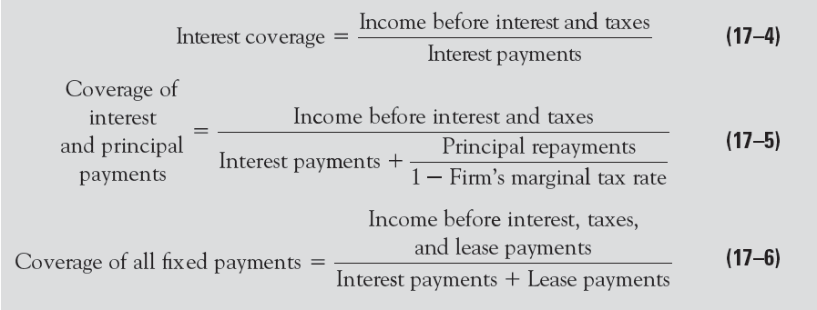
Financial Ratio Analysis: Coverage Ratio
It measures the adequacy of earnings
Coverage refers to the protection afforded creditors based on the amount of a business customer’s earnings
The best-known coverage ratios include:

Slide 35
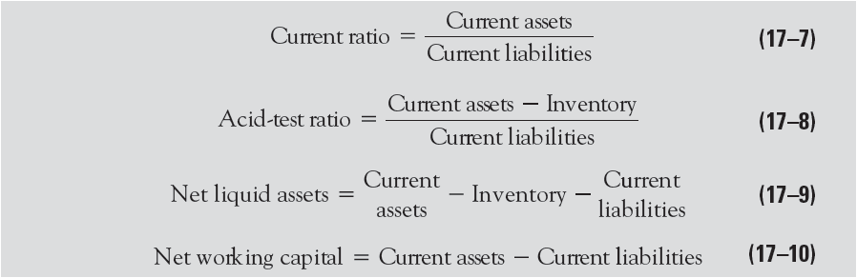
Financial Ratio Analysis: Liquidity Indicator
Reflects the borrower’s ability to raise cash in timely fashion at reasonable cost, including the ability to meet loan payments when they come due

Slide 36
Financial Ratio Analysis: Liquidity Indicator Cont..
Commercial lenders are particularly sensitive to changes in customer’s liquidity position; conversion of liquid assets, including cash accounts usually fund loan repayments
Erosion of customers liquidity position increases the risk that the lender will have to attach the customer’s lesser liquid assets to recover funds; hence time consuming, costly and uncertain
Excess liquidity has forgone opportunity cost in terms of income producing assets
Excess liquidity also invites dishonest managers and employees to “take the money and run”

Slide 37
Financial Ratio Analysis: Profitability Indicator
How much net income remains for the owners of a business firm after all expenses (except dividends) are charged against revenue?
Popular bottom line indicators include:
Before-tax net income / total assets, net worth, or total sales
After-tax net income / total assets (or ROA)
After-tax net income / net worth (or ROE)
After-tax net income / total sales (or ROS) or profit margin

Slide 38
Financial Ratio Analysis: Financial Leverage Factor
It is the barometer of a business firm’s capital structure
Any lender is concerned about how much debt a borrower has taken on in addition to the loan being sought
Financial leverage: use of debt in the hope the borrower will generate earnings that exceeds the cost of debt, thereby increasing returns to a business firm’s owners

Slide 39
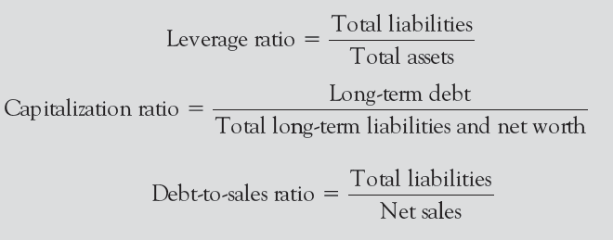
Financial Ratio Analysis: Financial Leverage Factor
Key financial ratios used to analyze any borrowing business’s credit standing and use of financial leverage include

Slide 40
Historical analysis of financial statement
Balance sheet for a Company
 | Most recent year |  | One year ago |  | Two years ago |  | Three years ago
Balance sheet items | Dollar Value | Percentage of Total | Dollar Value | Percentage of Total | Dollar Value | Percentage of Total | Dollar Value | Percentage of Total
Assets
Cash | 2.0 | 6.1% | 2.3 | 6.8% | 2.7 | 7.7% | 3.2 | 8.6%
Marketable securities | 1.5 | 4.5% | 1.8 | 5.3% | 2.0 | 5.7% | 1.0 | 2.7%
Accounts receivable | 9.3 | 28.2% | 8.4 | 24.7% | 7.2 | 20.6% | 5.1 | 13.8%
Inventories | 6.2 | 18.8% | 5.5 | 16.2% | 4.4 | 12.6% | 3.3 | 8.9%
Total Current Assets | 19.0 | 57.6% | 18.0 | 52.9% | 16.3 | 46.6% | 12.6 | 34.1%
Fixed asset, gross | 20.4 | 61.8% | 21.2 | 62.4% | 22.5 | 64.3% | 23.4 | 63.2%
Less: Accumulated Depriciation | 11.1 | 33.6% | 10.2 | 30.0% | 9.0 | 25.7% | 6.1 | 16.5%
Fixed asset, net | 9.3 | 28.2% | 11.0 | 32.4% | 13.5 | 38.6% | 17.3 | 46.8%
Other asset | 4.7 | 14.2% | 5.0 | 14.7% | 5.2 | 14.9% | 7.1 | 19.2%
Total Asset | 33.0 | 100.0% | 34.0 | 100.0% | 35.0 | 100.0% | 37.0 | 100.0%
Liabilities and Equity
Accounts payable | 2.3 | 7.0% | 2.2 | 6.5% | 1.8 | 5.1% | 2.0 | 5.4%
Notes payable | 4.9 | 14.8% | 4.4 | 12.9% | 4.2 | 12.0% | 3.7 | 10.0%
Taxes payable | 0.1 | 0.3% | 0.2 | 0.6% | 0.1 | 0.3% | 0.8 | 2.2%
Total current liabilities | 7.3 | 22.1% | 6.8 | 20.0% | 6.1 | 17.4% | 6.5 | 17.6%
Long-term debt | 13.2 | 40.0% | 13.2 | 38.8% | 13.5 | 38.6% | 12.4 | 33.5%
Other liabilities | 1.0 | 3.0% | 1.4 | 4.1% | 4.5 | 12.9% | 7.1 | 19.2%
Total Liabilites | 21.5 | 65.2% | 21.4 | 62.9% | 24.1 | 68.9% | 26.0 | 70.3%
Common stock | 2.0 | 6.1% | 2.0 | 5.9% | 1.0 | 2.9% | 1.0 | 2.7%
Paid-in surplus | 3.0 | 9.1% | 3.0 | 8.8% | 3.0 | 8.6% | 3.0 | 8.1%
Retained earnings | 6.5 | 19.7% | 7.6 | 22.4% | 6.9 | 19.7% | 7.0 | 18.9%
Total net worth | 11.5 | 34.8% | 12.6 | 37.1% | 10.9 | 31.1% | 11.0 | 29.7%

Slide 41
Income statement
Net sales | 33.0 | 100.0% | 31.0 | 100.0% | 29.0 | 100.0% | 32.0 | 100.0%
Less: Cost of goods sold | 19.0 | 57.6% | 17.0 | 54.8% | 16.0 | 55.2% | 15.0 | 46.9%
Gross Profit | 14.0 | 42.4% | 14.0 | 45.2% | 13.0 | 44.8% | 17.0 | 53.1%
Less: Selling, administrative and other expenses | 9.0 | 27.3% | 9.0 | 29.0% | 8.0 | 27.6% | 11.0 | 34.4%
Less: Depriciation expense | 3.0 | 9.1% | 3.0 | 9.7% | 3.0 | 10.3% | 2.0 | 6.3%
Net Operating Income | 2.0 | 6.1% | 2.0 | 6.5% | 2.0 | 6.9% | 4.0 | 12.5%
Less: Interest Expense on borrowed funds | 2.0 | 6.1% | 1.0 | 3.2% | 2.0 | 6.9% | 2.0 | 6.3%
Net income before taxes | 0.0 | 0.0% | 1.0 | 3.2% | 0.0 | 0.0% | 2.0 | 6.3%
Less: Income taxes | 0.1 | 0.3% | 0.3 | 1.0% | 0.1 | 0.3% | 0.2 | 0.6%
Net income after taxes | -0.1 | -0.3% | 0.7 | 2.3% | -0.1 | -0.3% | 1.8 | 5.6%

Slide 42
Historical Analysis of Financial Statement: Expense Control
Cost of goods sold/net sales | 57.6% |  | 54.8% |  | 55.2% |  | 46.9%
Selling, administrative and other expenses/ net sales | 27.3% |  | 29.0% |  | 27.6% |  | 34.4%
Depriciation expenses/net sales | 9.1% |  | 9.7% |  | 10.3% |  | 6.3%
Interest expense on borrowed funds/net sales | 6.1% |  | 3.2% |  | 6.9% |  | 6.3%
Taxes/net sales | 0.3% |  | 1.0% |  | 0.3% |  | 0.6%
Selling, administrative and other expenses, and taxes relative to net sales have declined; rest have either remained steady or risen as a percentage of net sales
The inability to reduce the overall expense in the face of a relatively flat sales has caused net earnings to decline over the past four years
Highly convincing arguments are needed to convince that the firm’s expense and earning picture will improve

Slide 43
Historical Analysis of Financial Statement: Operating Efficiency
Inventory turnover ratio: Annual cost of goods and services sold/average inventory | 3.06 |  | 3.09 |  | 3.64 |  | 4.55
Average collection period: Accounts receivable /(annual sales/360) in days | 101.5 |  | 97.5 |  | 89.4 |  | 57.4
Turnover of fixed assets:
Net sales/net fixed assets | 3.55 |  | 2.82 |  | 2.15 |  | 1.85
Turnover of total assets:
Net sales/total assets | 1.00 |  | 0.91 |  | 0.83 |  | 0.86
Inventory turnover-indicator of managements efficiency in controlling size of firms inventory – has declining trend
Average collection period is increasing; suggests rise in past due accounts and poor collection
Although fixed asset turnover is rising, (refer B/S) primary reason is decline of plant and equipment – firm either selling assets to raise cash or simply not replacing worn out capital

Slide 44
Historical Analysis of Financial Statement: Marketability of Product Line
 | Most recent year | One year ago | Two years ago | Three years ago
Gross Profit Margin | 42.4% | 45.2% | 44.8% | 53.1%
Net Profit Margin | -0.3% | 2.3% | -0.4% | 5.8%
Both Gross profit margin and net profit margin are on a downward trend
There might be potential problems, including potentially inappropriate pricing policies, expense control problems, and market deterioration

Slide 45
Coverage Ratio Analysis
Interest coverage is weak
Its earnings are barely adequate to cover the interest payments, and once repayment of principal is included, earnings are simply inadequate to cover interest and principal payments
Firm must use less debt to finance itself and boost its earnings
Lengthen its dent repayment through restructuring, so that current debt service payments are reduced

Slide 46
Historical Analysis of Financial Statement: Liquidity
Liquidity
Current ratio: Current asset/current liabilities | 2.60 |  | 2.65 |  | 2.67 |  | 1.94
Acid-test: (current asset- inventories)/current liabilities | 1.75 |  | 1.84 |  | 1.95 |  | 1.43
Working capital= current asset-current liabilities | 11.70 |  | 11.20 |  | 10.20 |  | 6.10
Net liquid asset= current asset-inventories-current liabilities | 5.50 |  | 5.70 |  | 5.80 |  | 2.80
Firm made substantial progress in building up its liquidity two years ago: current asset 3 times over current liabilities
Current and acid test ratios have dipped significantly in the recent year
Good thing: recent expansion of working capital of $9.7 million and its relatively stable net liquid asset
However, large part of working capital increase is from selling off the firm’s plant and equipment and through use of debt

Slide 47
Historical Analysis of Financial Statement: Profitability
Profitability
Before tax net income/total asset | 0.00% |  | 2.94% |  | 0.00% |  | 5.41%
After tax net income/total asset | -0.30% |  | 2.06% |  | -0.29% |  | 4.86%
Before tax net income/net worth | 0.00% |  | 7.94% |  | 0.00% |  | 18.18%
After tax net income/net worth | -0.87% |  | 5.56% |  | -0.92% |  | 16.36%
Long term decline in profitability
Little evidence to suggest a turn around

Slide 48
Historical Analysis of Financial Statement: Leverage
Leverage:
Leverage ratio: Total liabilities/total asstes | 65.2% |  | 62.9% |  | 68.9% |  | 70.3%
Total liabilities/net worth | 1.87 |  | 1.70 |  | 2.21 |  | 2.36
Capitalization ratio: Long term debt /long term debt plus net worth | 53.4% |  | 51.2% |  | 55.3% |  | 53.0%
Debt-to-sales ratio:Total liabilities/net sales | 65.2% |  | 69.0% |  | 83.1% |  | 81.3%
Leverage ratio has improved, with assets and net worth generally growing faster than debt
Its mix of funding sources: debt and equity capital has been relatively constant while total liabilities have declined relative to sales
Much of firms asset has come from sources other than debt, such as depletion of fixed assets and a buildup on current assets like accounts receivable and inventories

Slide 49
Industry comparison
It is standard practice to compare each business customer’s performance to the performance of the customer’s entire industry
It gives the idea about the sustainability and successful business strategy of the companies in comparison with industry average

Slide 50
Contingent Liabilities
Usually not shown on customer balance sheets are other potential claims against the borrower:
Guarantees and warranties behind the business firm’s products
Litigation or pending lawsuits against the firm
Unfunded pension liabilities
Taxes owed but unpaid
Limiting regulations

Slide 51
Contingent Liabilities …
These contingent liabilities can turn into actual claims against the firm’s assets and earnings at a future date
The loan officer must ask the customer about pending or potential claims against the firm
Following up the own investigation by the bank from government records, public notices and news papers

Slide 52
Environmental liabilities
Environmental clearance
Hazardous activities which are debarred by the environmental laws
Possible lender liability of environmental damage as per regulation
Lenders’ environmental risk assessment programme

Slide 53
Underfunded Pension Liabilities
Borrowing customers should record employee pension plan surpluses and deficits on their balance sheets
If projected pension-plan liabilities exceed expected funds sources, the result may be an increase in liabilities
Increases the price of loan

Slide 54
Analysis of Cash Flow Statement
The Statement of Cash Flows illustrates how cash receipts and disbursements are generated by operating, investing, and financing activities
Will the borrower be able to generate sufficient cash to support its production and sales activities and still be able to repay the lender?
Why is the cash position of the borrower changing over time and what are the implications of these changes?

Slide 55
Cash flow from investment activities
Purchase of new machinery
Redemption of marketable securities

Slide 56
Cash flow from financing activities
Increase in notes payable
Repayment of long-term debt
Repayment of other liabilities
Dividends paid

Slide 57
Other Factors
Broader, long-term relationship
Denial of loans affects the deposit base, personal accounts of stock holders and employees
Longer-term loan policy
Relaxing the requirements

Slide 58
Objectives of loan pricing
Maintain Margins
Balance risk-return profile
Ensure market rates

Slide 59
Margin Maintenance
Average cost of funds vs. marginal cost of funds
Deployment of excess deposit: Average cost of funds
If banks does not have any surplus fund and credit requirements are funded using the incremental deposits: Marginal cost of funds

Slide 60
Risk-return profile
Tenor of loan
Long term loans are riskier than short-term loan
Mismatch between maturity of assets and liabilities
Maximum tenor should be fixed accordingly
Credit risk
Probability of default of loans
Size of loan
It affects servicing cost

Slide 61
Market rates
Loan price should be based on market rate structure prevailed in the market at that point of time
Marginal cost of lending Rate (MCLR)
It is an internal reference rate for banks to determine the interest they can charge on loans.
Additional or incremental cost of arranging additional rupee for a prospective buyer has been taken into account
Factors considered for MCLR: Tenor of loan, marginal cost of funds, operating cost, negative carry on account of CRR
Base rate
It is the minimum rate set by the Reserve Bank of India below which banks are not allowed to lend to its customers. (not used since 2016 in India)

Slide 62
Cost plus loan pricing model
Measure cost of funds
Assess the servicing costs
Quantify the credit risk and set premium
Assess the profit margin that ensures ROE
Relate the rate to a reference rate
Ensure market presence

Slide 63
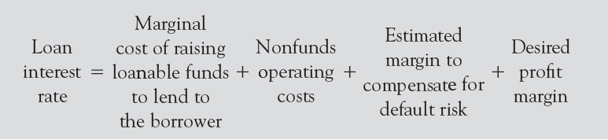
Cost plus loan pricing model
If the bank is not a position to identify the sources from which the funds are used to extend a particular credit facility, the average cost of funds (ACF) will be the suitable option
If the banks can clearly segregate its liabilities then it can use pooled cost of funds with similar maturities
Loan price= Cost of funds + margin

Slide 64
Example
Maturity | Amount (Rs. Crore) | Rate
0 | 15 | 0.00
6 moths | 25 | 5.00
1year | 15 | 10.00
2 years | 15 | 12.00
3 years | 30 | 13.00
Compute the loan price using ACF and MCF approach for a loan proposal of Rs. 30 crore for 3 years?
Average cost of funds: 25*0.05 + 15*0.1+ 15*0.12+ 30*0.13= 8.45
If margin is 2% then loan price: 8.45 + 2= 10.45%
Pooled cost of funds: 13% + 2% = 15%

Slide 65
Example cont…
Cost of servicing: 3%, risk margin: 0.25%, profit margin: 1.25%
Loan Price using ACF = 8.45% + 3% + 0.25% + 1.25% = 12.95%
Loan Price using MCF= 13% + 3% + 0.25% + 1.25% =17.5%
The profit margin which the bank sets should enable the bank to earn its required ROE
When required ROE is met then the price charge which is known as contractual rate becomes expected return for that loan

Slide 66
Cost plus loan pricing model …
Bank will earn expected return as long as there is no default payment of the loan
In the presence of default, the contractual rate will not give the bank the expected return.
If the bank has to reach the targeted ROE, then the risk should be quantified to arrive at a contractual rate that in turn gives the bank the expected rate
When a default is expected from a loan, the bank adjusts the recovered amount towards the principal

Slide 67
Cost plus loan pricing model …
E (R) = P1(r) + P2 [(Principal (1+r) *R)/Principal -1]
P1 = Probability of repayment
P2=Probability of default
R= Recovery rate
P1(r)= Returns using the contractual rate (probability of total payment of the loan in the normal course of payment)

Slide 68
Example
Loan= Rs. 1500 cr, Avergae contractual rate: 14%, probability of repayment= 90%, recovery rate= 80%
E(r) = 11.72%
The difference between E(r) and contractual rate arises due to 80% recovery rate and 90 % repayment rate

Slide 69
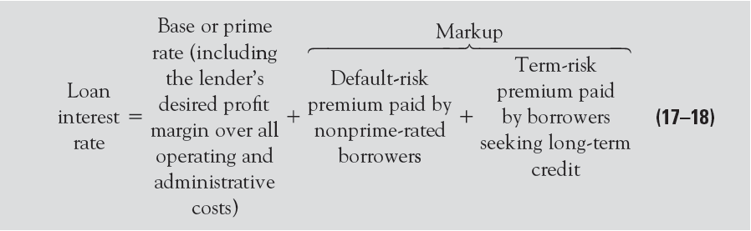
The Price Leadership Model
Leading commercial lenders have switched to LIBOR-based loan pricing due to the growing use of Eurocurrencies as a source of loanable funds
LIBOR-based loan rate = LIBOR + Default-risk premium + Profit margin

Slide 70
Below-Prime Market Pricing
Banks announced that some large corporate loans covering only a few days or weeks would be made at low money market interest rates
Federal funds rate on domestic loans plus a small margin

Slide 71
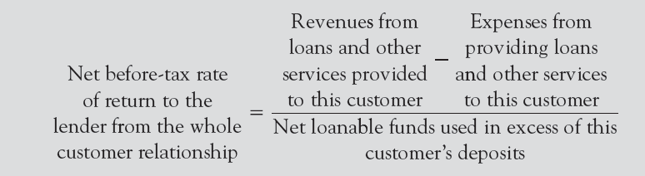
Customer Profitability Analysis (CPA)
17-71
Assumes that the lender should take the whole customer relationship into account when pricing a loan

Slide 72
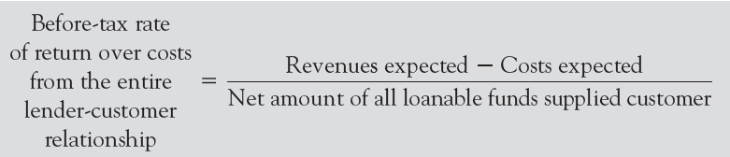
Customer Profitability Analysis (CPA) Cont…
17-72
If the net rate of return is positive, the proposed loan is acceptable because all expenses have been met
If the net rate of return is negative, the proposed loan and other services provided to the customer are not correctly priced as far as the lender is concerned
The greater the perceived risk of the loan, the higher the net rate of return the lender should require

Slide 73
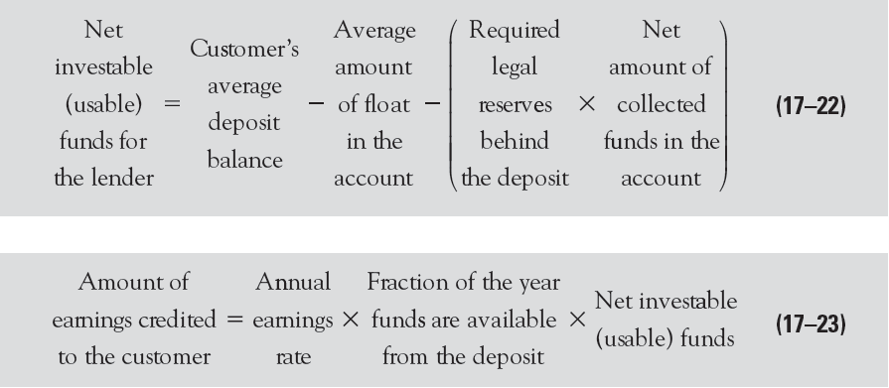
Customer Profitability Analysis (CPA) Cont…
17-73
Earnings Credit for Customer Deposits
In calculating how much in revenues a customer generates for a lending institution, many lenders give the customer credit for any earnings received from investing the balance in the customer’s deposit account

Slide 74
Types of Loans Granted to Consumers
Consumer loans are classified by
Purpose – what the borrowed funds will be used for
Type – whether the borrower must repay in installments or repay in one lump sum
Combination of both loan types and loan purpose

Slide 75
Types of Loans Granted to Consumers: Residential Loans
Credit to finance purchase of a home or fund improvements on a private residence
Usually a long-term loan, typically bearing a term of 10 to 30 years
Secured by the property itself
May carry either a fixed interest rate or a variable (floating) interest rate

Slide 76
Types of Loans Granted to Consumers: Nonresidential Loans
Installment Loans | Noninstallment Loans
Short-term to medium-term loans Repayable in two or more consecutive payments (usually monthly or quarterly) Used to buy big-ticket items (e.g., automobiles, furniture, and home appliances) or to consolidate existing household debts | Short-term loans individuals and families draw upon for immediate cash needs Repayable in a lump sum May be for relatively small amounts and include charge accounts that often require payment in 30 days or less May also be made for a short period (usually six months or less) to wealthier individuals and can be quite large

Slide 77
Types of Loans Granted to Consumers: Credit Card Loans & Revolving Credit
One of the most popular forms of consumer credit today is accessed via credit cards
Offer their holders access to either installment or non-installment credit
Credit card users can be installment users and non-installment users
Installment users of credit cards are far more profitable due to the interest income they generate
Card providers also earn discount fees (usually 1 to 7 percent of credit card sales) from merchants who accept their cards

Slide 78
Characteristics of Consumer Loans
Consumer loans are profitable credits with “sticky” interest rates
Typically prices above the cost of funding them but contract interest rates often don’t change readily with market conditions as do most business loans ; exposed to significant interest rate risk
Tend to be cyclically sensitive : rise in periods of economic expansion when consumers are more optimistic about future
Relatively interest inelastic: more concerned about the size of monthly payments required by a loan agreement than the interest rate charges
Education & income level influence on use of credit
Borrowing often used to achieve a standard of living than a safety net to be used only in emergencies

Slide 79
Evaluating Consumer Loan Applications: Character & Purpose
Character of borrower
Lender must be assures that the borrower feels a keen sense of moral responsibility to repay loan on time
Fundamental character of borrower revealed through purpose of loan request
Lender must ask:
Has the customer clearly stated what he or she plans to do with the money?
Is the stated purpose of loan consistent with the lender’s loan policy?
Is there evidence of sincere intension to repay any funds borrowed?

Slide 80
Evaluating Consumer Loan Applications: Character & Purpose Cont..
Borrower’s ability to pay
Borrowers income and valuable assets must be sufficient to reassure the lender that the customer has the ability to repay loan with a comfortable margin of safety
Lenders must check with one or more regional or national credit bureaus
Credit Bureaus are institutions that hold files on most individuals who have borrowed money, indicating their record of repayment and credit rating
Incase borrower is without a credit record or with a poor track record of repaying loans, a cosigner may be requested to support the repayment

Slide 81
Evaluating Consumer Loan Applications: Other Factors
Income Levels: | Both size and stability of an individual’s income are considered Customer to report net salary, take home salary With large loans, check with customers employer to verify accuracy
Deposit Balances | It is an indirect measure of income size and stability Right to offset: permits the lender to call a loan that is in default and seize any checking savings deposits the customer may hold in order to recover its funds
Employment and Residential Stability | Duration of employment considered while granting a sizable loan to someone Length of residency: longer period stays in one residency; the more stable
Pyramid of Debt | Individuals draws credit at one lending institution to pay another is frowned upon

